Slide 1
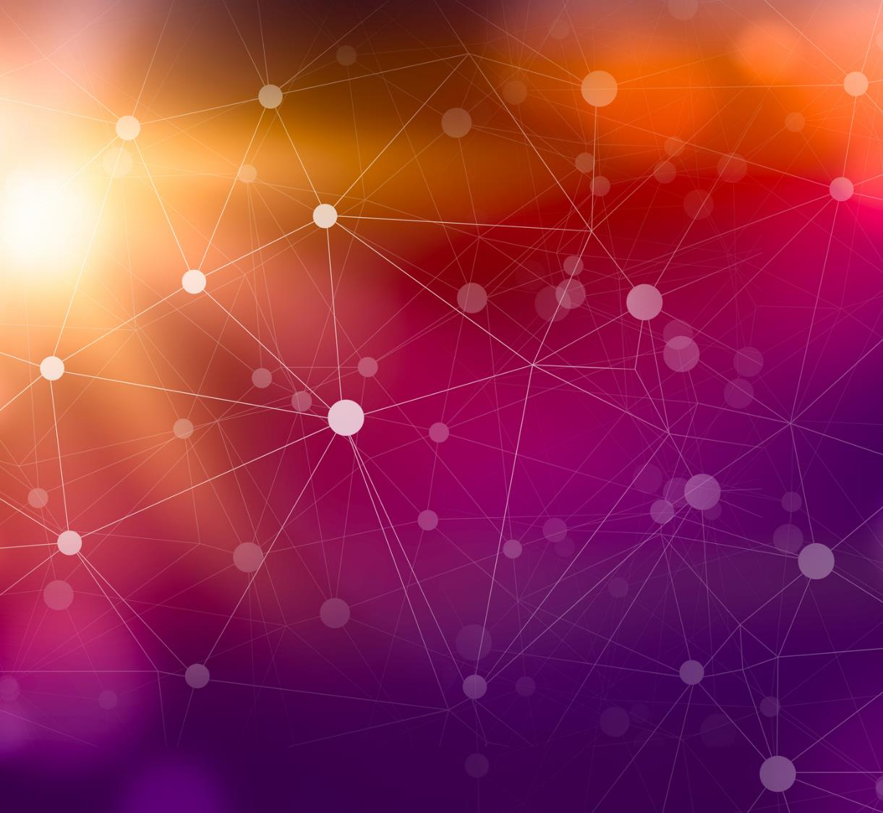
A Comparative Analysis of Deep Learning Models for Alzheimer’s Disease Classification
Submitted to:

Slide 2
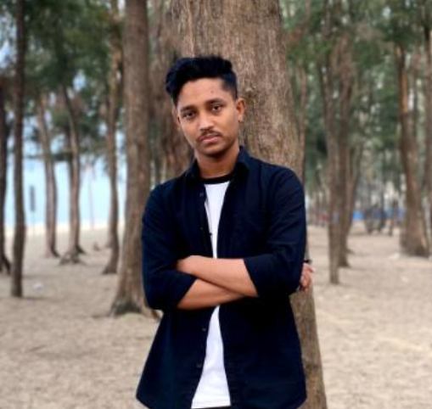
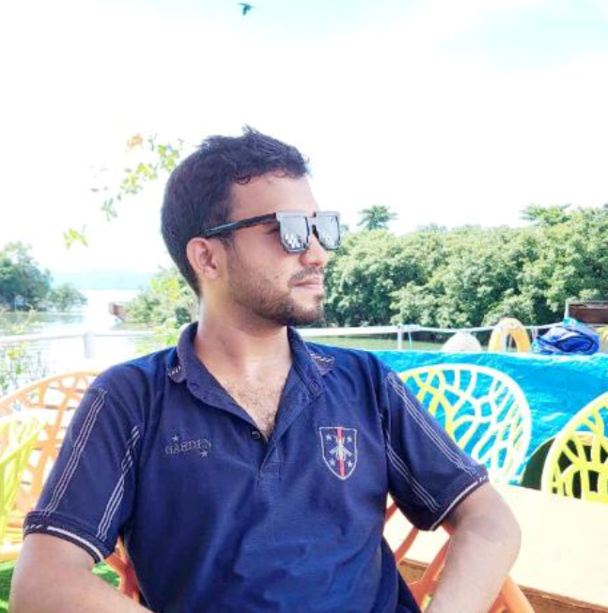

Group Members
Md Abed Afnan
C211051
S M Arif Uddin
C211072
Fahim Reza
C211046

Slide 3
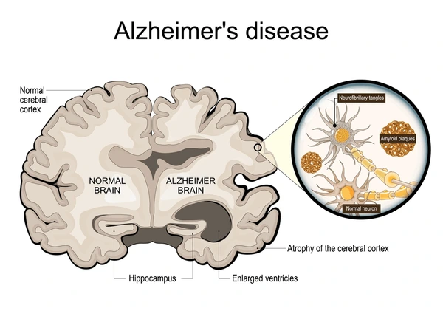
Introduction
Alzheimer's is a brain disease that slowly destroys memory and thinking skills.
Deep learning opens new possibilities for early and accurate detection of Alzheimer's disease.
We Achieved 98-99% accuracy in Alzheimer's classification using ResNet50 and CNN on OASIS MRI brain image dataset.

Slide 4
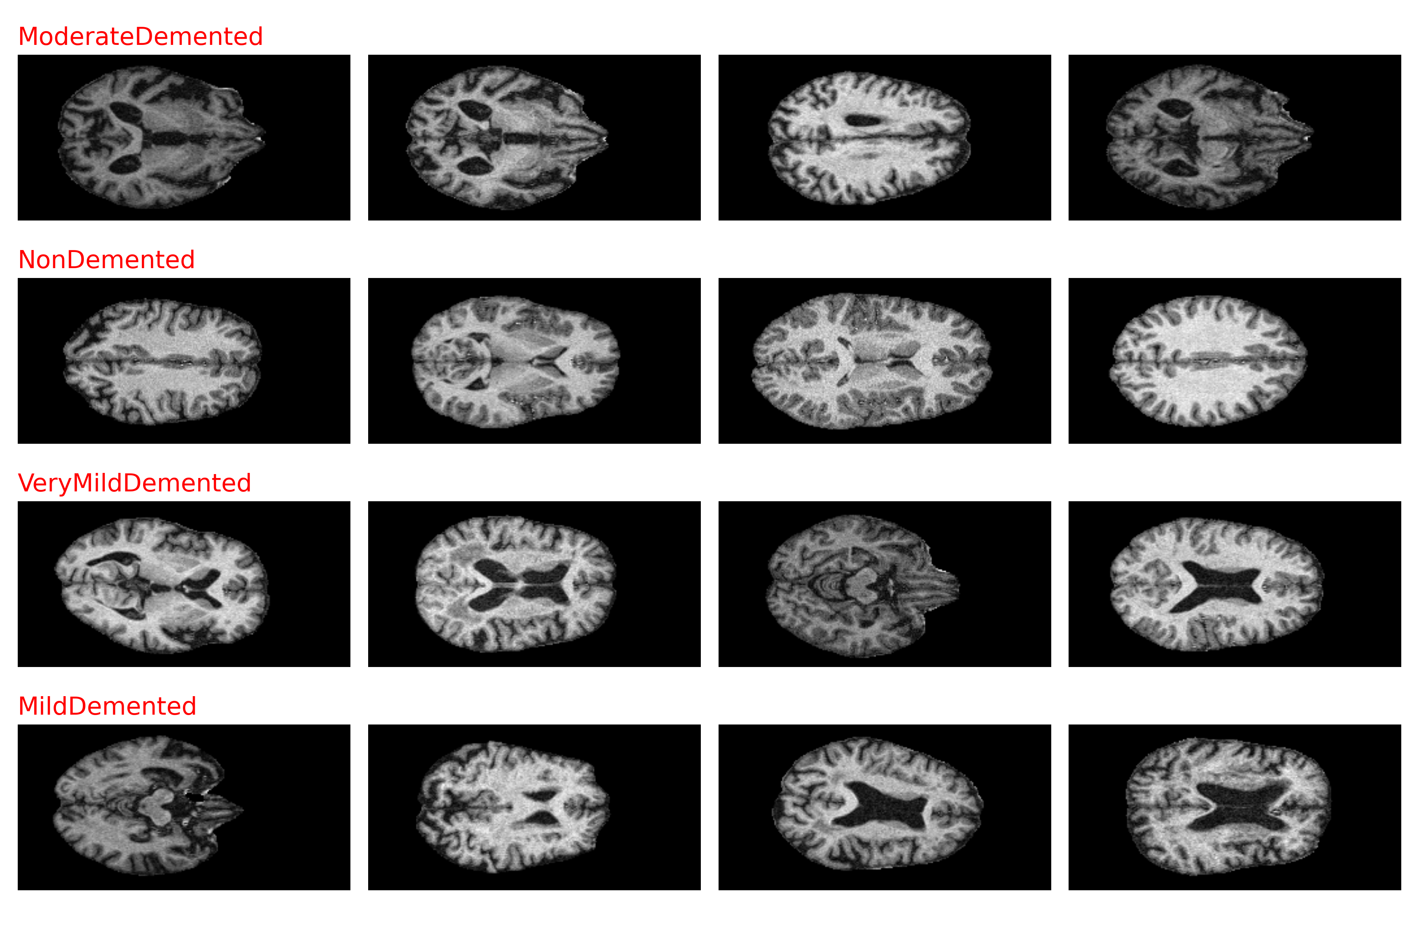
Dataset
01
OASIS dataset from Kaggle.
02
Data are distributed in 4 classes:
MildDemented
ModerateDemented
NonDemented
VeryMildDemented

Slide 5
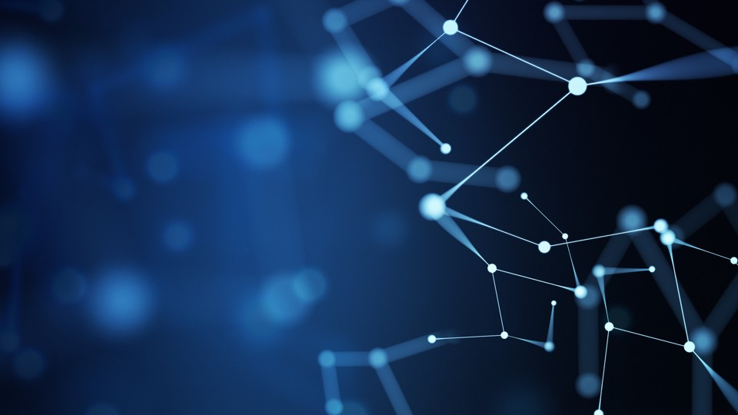
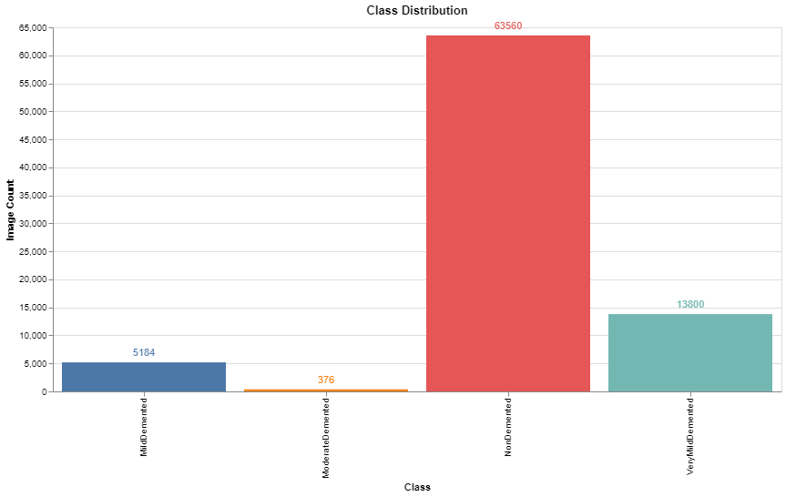
Dataset Cont.
01
MildDemented: 5184
ModerateDemented: 376
NonDemented: 63560
VeryMildDemented: 13800
02
IMBALANCE DATASET
03
Need Sampling, Augmentation
03
Used WeightedSampler to address class imbalance

Slide 6
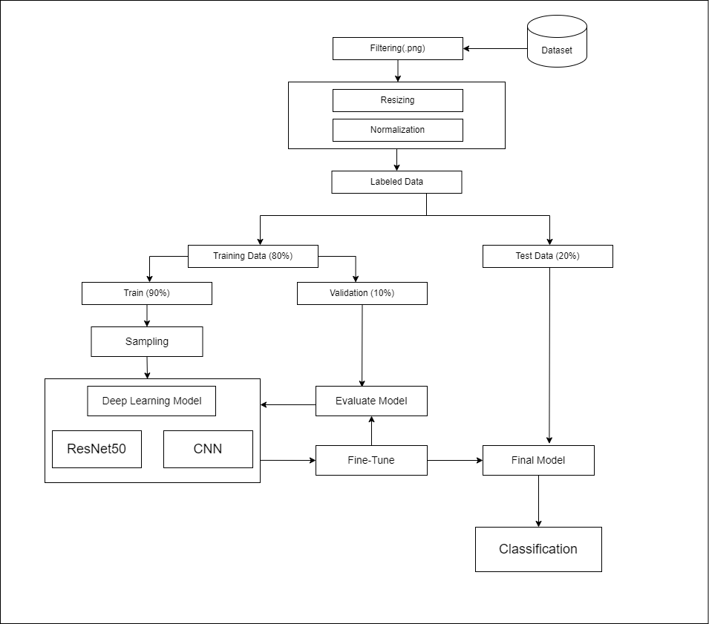
Workflow Diagram
01
Files without the .png extension are skipped.
02
Images are resized to 224x224 pixels.
03
Normalized for 3-channel input with mean = [0.485, 0.456, 0.406] and standard deviation = [0.229, 0.224, 0.225].
04
Each image is labeled with its corresponding class from one of the four classes.
05
DATASET
80% for Training
90% Train Data
10% Validation Data
20% for Testing

Slide 7

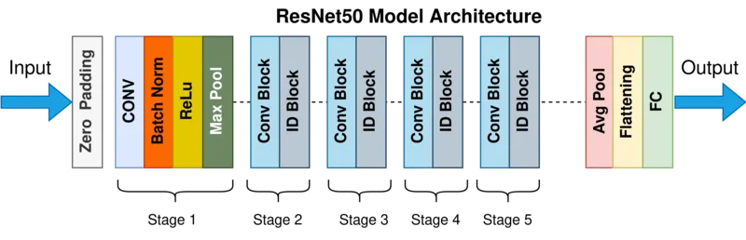
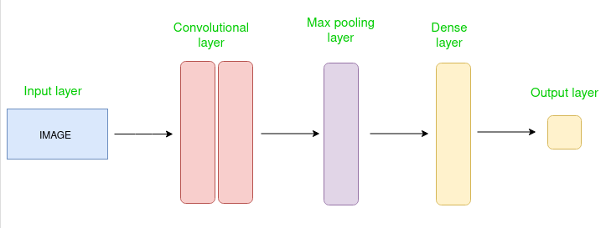
Models
ResNet50: A pre-trained convolutional neural network with custom dense layer and dropout for better classification on our dataset.
Fig. Pre-Trained ResNet50 Architecture
CNN: A 3-convolution layer architecture is designed with dropout for regularization and handle misclassification
Fig. Basic CNN Workflow Diagram

Slide 8
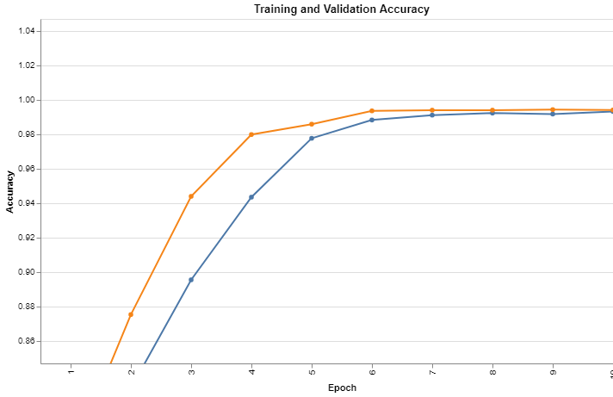
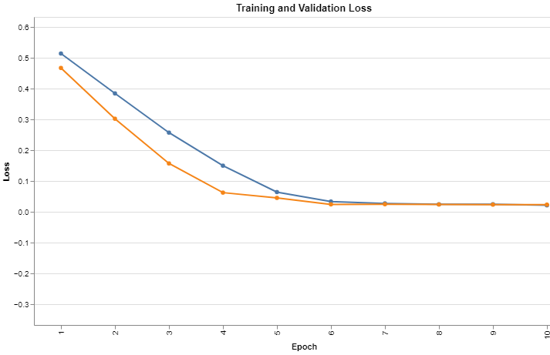
Evaluations On CNN
Final Train Acc:0.99
Final Val Accuracy: 0.99
Final Train Loss: 0.0219
Final Val Loss: 0.0241

Slide 9
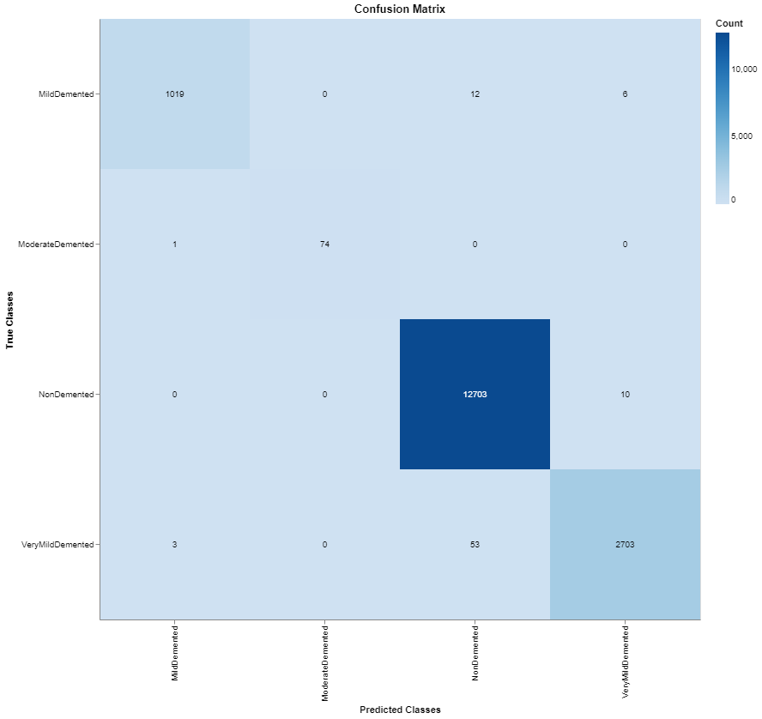
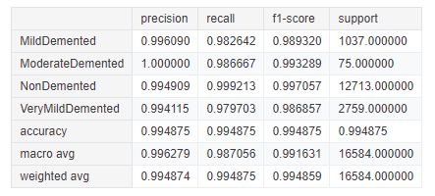
CNN Cont.

Slide 10
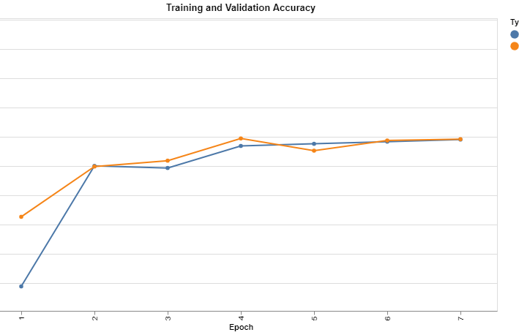
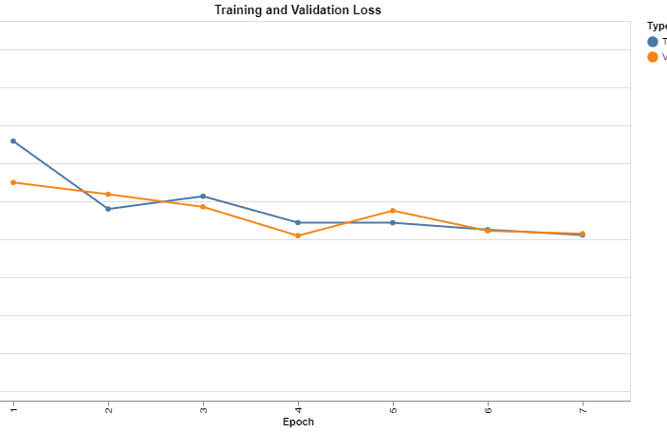
Evaluations On ResNet50
Final Train Accuracy: 1.00
Final Val Accuracy: 1.00
Final Train Loss: 0.0102
Final Val Loss: 0.0136

Slide 11

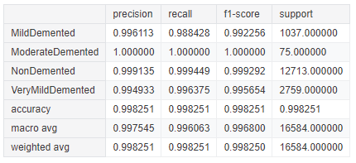
ResNet Cont.

Slide 12
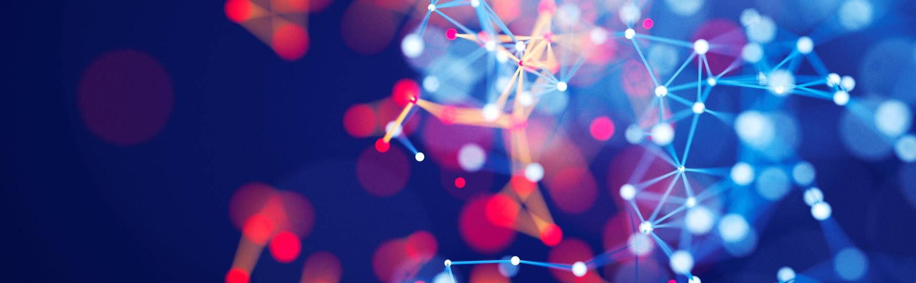
Summary
With PowerPoint, you can create presentations and share your work with others, wherever they are. Type the text you want here to get started. You can also add images, art, and videos on this template. Save to OneDrive and access your presentations from your computer, tablet, or phone.

Slide 13
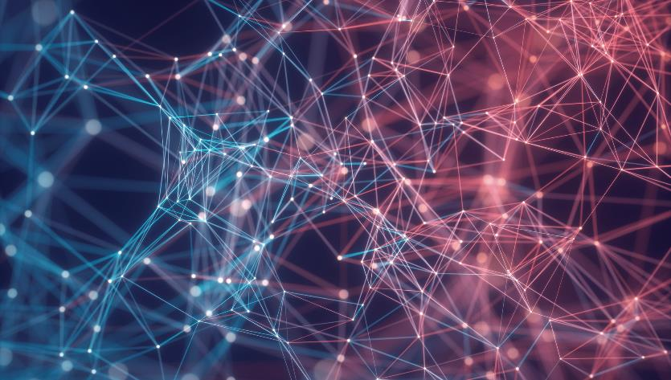
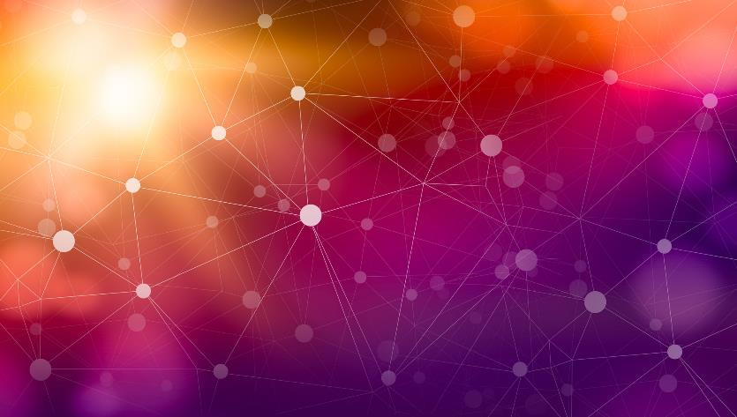
Thank You
Presenter name
Email address
Website address

